Slide 1
Vehicle Loan Default Prediction
Anshu Yadav
Data Scientist
Springboard

Slide 2
Problem Statement
Vehicle Loan default prediction is a common problem for various financial companies and a well defined and known problem in data science
This data is from L&T Financial Services & Analytics Vidhya
LTFS is one of India’s most respected & leading NBFCs providing finance for two-wheeler, farm equipment, housing, infra & microfinance.
I was trying to model future outcomes either vehicle loan is default or not.

Slide 3
The Source Data
This data is from L&T Financial Services & Analytics Vidhya for India
Initial shape - 233154 rows and 41 features
Data Wrangling:
Reviewed high and low outliers - removed when warranted
Columns having data in months and years were converted to months only
Missing values imputed to ‘missing’
Twenty-five features were selected because rest are unhelpful for analysis

Slide 4
Feature Creations
The following features were created to help with the modeling and data analysis:
Quantile-based discretization on disbursed amount of loan,asset cost, loan to vehicle
Count of loan default based on branch ID
Count of loan default based on unique ID
Number of loan default or no default cases based on disbursal date.

Slide 5
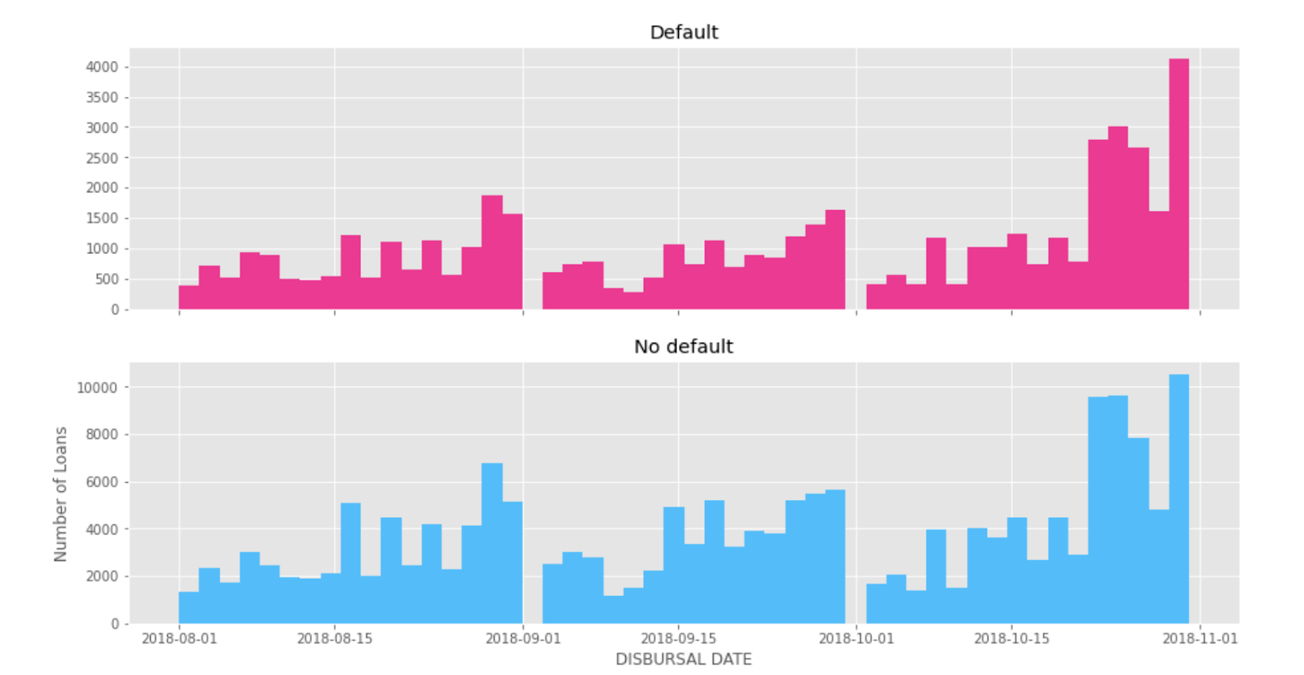
Exploratory Data Analysis
Histogram of number of loans vs Disbursal date

Slide 6
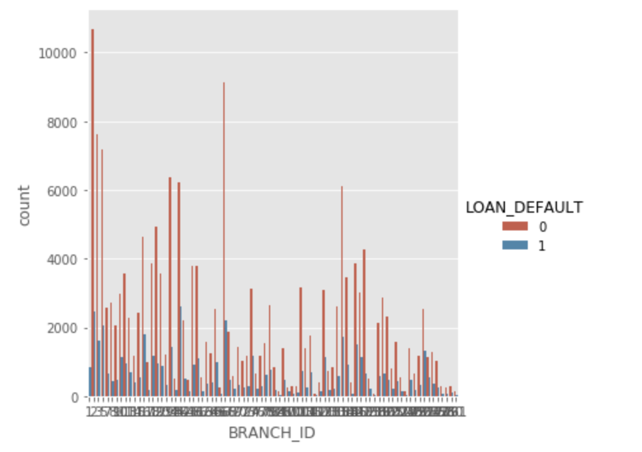
Exploratory Data Analysis
Count plot of branch id on the basis of Loan Default

Slide 7
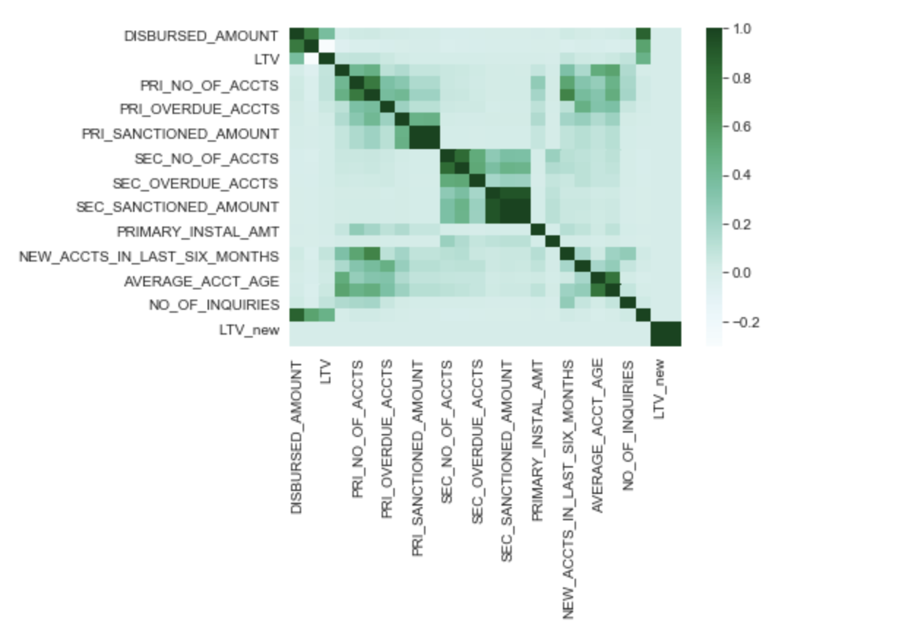
Exploratory Data Analysis
Count plot of branch id on the basis of Loan Default

Slide 8
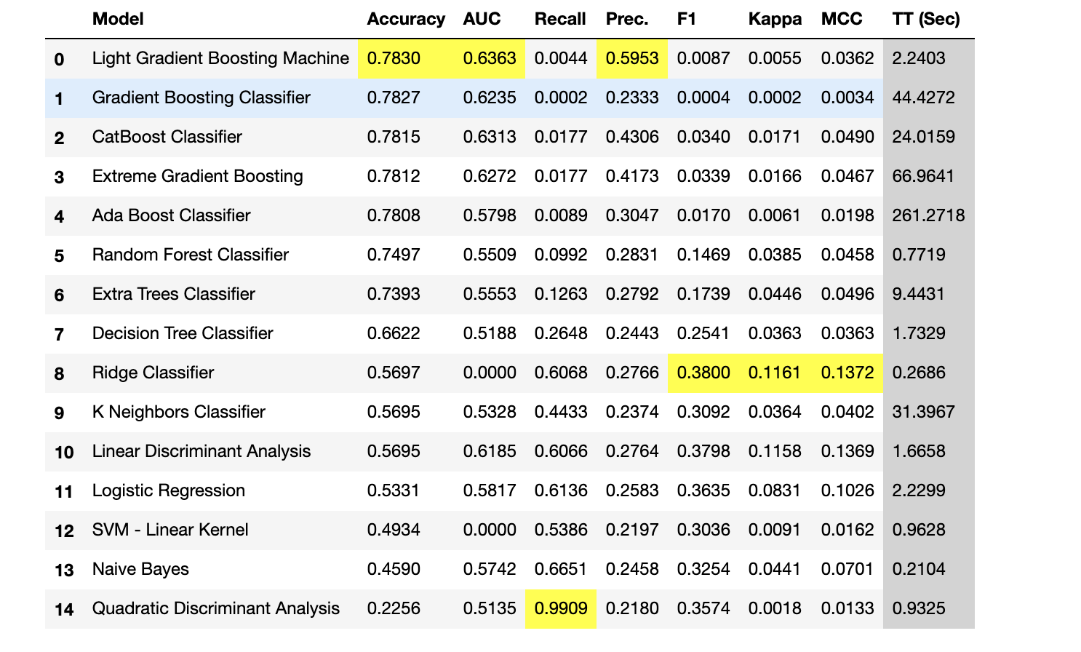
Data Modeling-Initial Finding
Average Accuracy is around 70%
AUC is around 60%
Boosting based models perform better

Slide 9
Model Selection
LGBM model selected
LGBM has maximum Accuracy(78.6%) and AUC (63.3%)

Slide 10

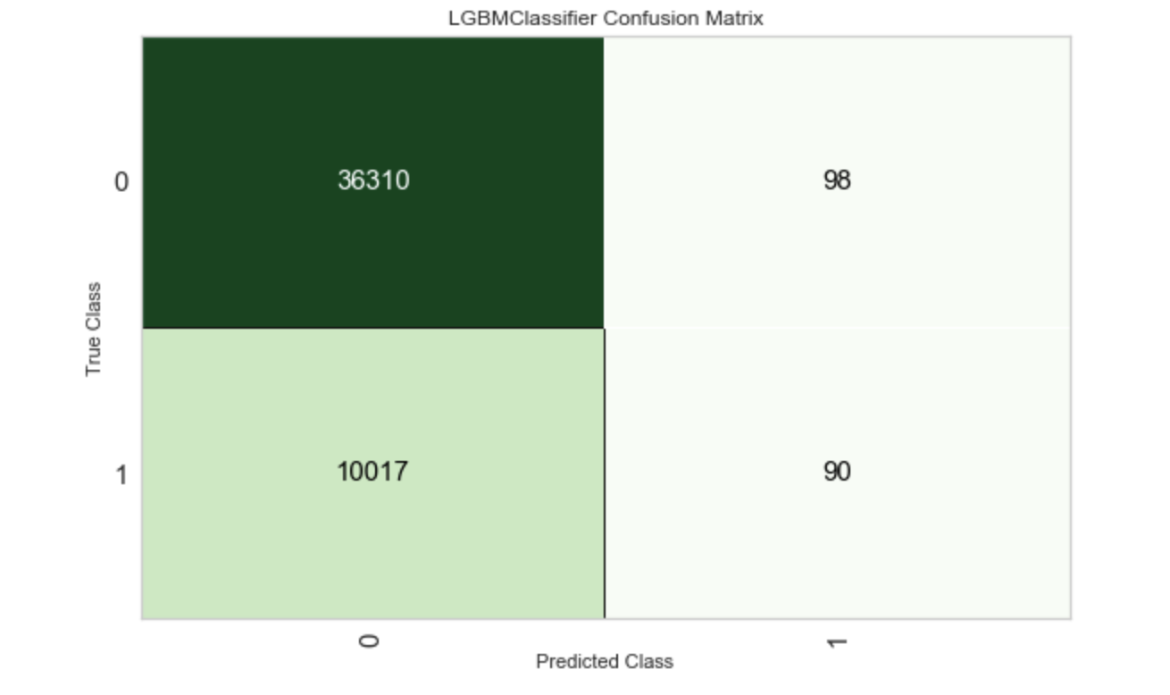
LGBM Model
The above confusion matrix shows that 90 of them are true positive(loan_default)
36310 are true negative(not a loan_default)cases.
Only 98 cases were found False negative.
There is a very high false positive rate of this mode

Slide 11


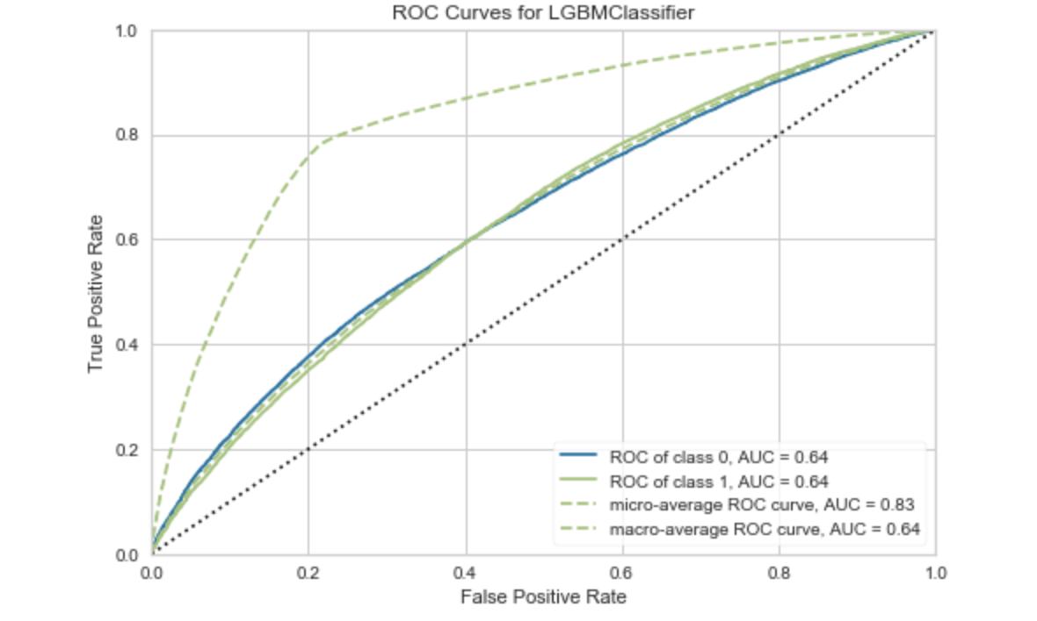

LGBM Model
The ROC for both default and no default cases was 64%.
Micro-average ROC is 83%

Slide 12
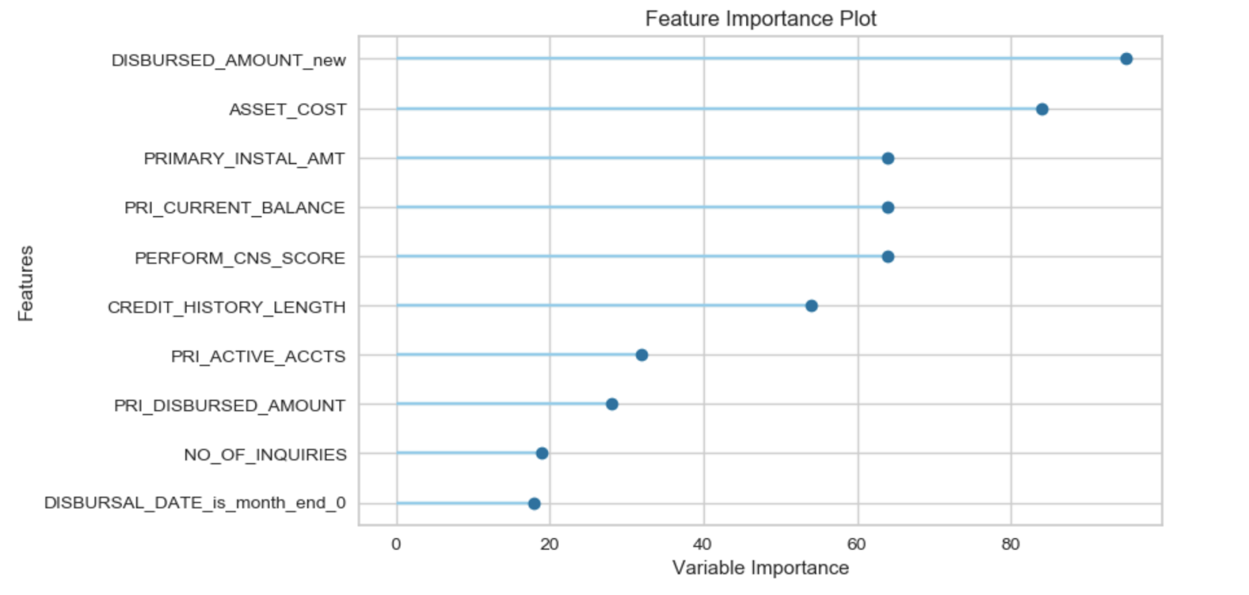
LGBM Model-Feature Selection
Disbursed amount, asset cost are the most effective feature among selected one for this model.

Slide 13
Conclusions
With the Accuracy 78.7% and AUC 68% shows that this model is okay for prediction of loan default use cases
Important feature of the dataset is the imbalance in outcomes and how we can deal with that.

Slide 14
Future Research
Different machine learning architecture such as neural networks could provide better results.
Deep learning can be another way to discover and push the boundaries of what is possible in predicting the outcome of loans.
We could as well ensemble models to make better predictions.
Relaxing the strict requirements could help capture the false negative market and that could lead to better profitability to the bank that finds a way.

